Slide 1


CSE240
Introduction to Programming Languages
Chapter 5
Logic Language Prolog
Lecture 26
Graph, Structure, Parameter Passing, Recursion, and List
Reading: Textbook Sections 5.4 and 5.5
Dr. Yinong Chen

Slide 2
Chapter 5 Outline
Introduction
Logic programming paradigm
Prolog programs: facts, rules, and goals
Factbase
Goals (Questions)
Rulebase
Compound questions
Arithmetic operations, graph, and basic recursion
More graph operations
Parameter Passing
More recursive programs
Structures of facts and rules
Pairs, lists and their operations
Flow Control

Slide 3
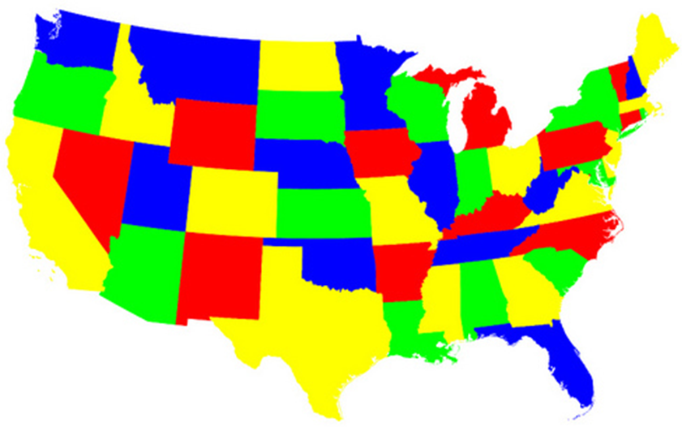
AI Application: Map Coloring
Neighboring states must use different colors
Graph model: Node = State and edge(X,Y) if they are adjacent
Washington
Oregon
Idaho
Wyoming
or
id
wy
Nevada
California
Utah
ca
ne
ut
Arizona
az

Slide 4
Factbase and rulebase
Neighboring States must use different colors
edge(az, ca).
edge(az, ne).
edge(az, ut).
edge(ca, ne).
edge(ca, or).
edge(ne, ut).
edge(ne, or).
edge(ne, id).
edge(ut, id).
edge(ut, wy).
edge(id, wy).
edge(or, id).
adjacent(X, Y) :-
edge(X, Y); edge(Y, X).
or
id
wy
or
id
wy
ca
ne
ut
ca
ne
ut
az
az
color(az, orange).
color(ca, yellow).
color(ne, red).
color(ut, yellow).
color(or, orange).
color(id, yellow).
color(wy, red).

Slide 5
Detecting the coloring error automatically
edge(az, ca).
edge(az, ne).
edge(az, ut).
edge(ca, ne).
edge(ca, or).
edge(ne, ut).
edge(ne, or).
edge(ne, id).
edge(ut, id).
edge(ut, wy).
edge(id, wy).
edge(or, id).
color(az, orange).
color(ca, yellow).
color(ne, red).
color(ut, yellow).
color(or, orange).
color(id, yellow).
color(wy, red).
Should Color1 = Color2 = Color3?
adjacent(X, Y) :-
edge(X, Y); edge(Y, X).
miscolor(S1, S2, Color1) :-
adjacent(S1, S2),
color(S1, Color2),
color(S2, Color3).
Yes
1
or
id
wy
1
Is it recursive?
ut
ca
ne
ut
| ?- miscolor(S1, S2, C).
C = yellow
S1 = ut
S2 = id ? ;
C = yellow
S1 = id
S2 = ut ? ;
no
az
Fix the coloring error
color(ut, green).
| ?- miscolor(S1, S2, C).
no

Slide 6
Summary of Parameter Passing: What are Allowed?
C/C++ Java Scheme Prolog
Call- always primitive always always
by-value
Call-
by-reference/ always object never always
by address
Return yes & yes & always true or false
value no (void) no
Function as first not always not always always never
class object
except display
never other
except display

Slide 7
Writing Recursive Rules in Prolog
Using the Four-Step Abstract Approach
Identify size-n problem;
Find the stopping condition and the return value at the stopping condition; Place the stopping rule before the recursive rule.
Identify size-m (e.g., m = n-1) problem and assume it will return the solution;
Construct the size-n problem solution based on the assumed size-m solution.

Slide 8
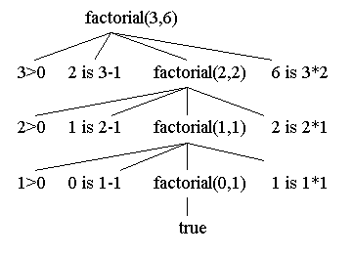
Recursion Example: Factorial
factorial(0,1) :- !, /* This cut “!” has nothing to do with factorial */
/* It removes backtrack points and reduce search options*/
write('Completed').
factorial(N,F) :-
N>0,
N1 is N-1,
factorial(N1,F1),
F is N * F1.
?- factorial(3, 6).
yes
factorial(N-1,F1)
yes
Algorithm: F = 1*2*3*...*N

Slide 9
Arithmetic Goals vs. Logical Goals
What will be returned?
?- factorial(3, F).
?- factorial(3, 5).
?- factorial(3, 6).
?- factorial(X, 6).
⇒ F = 6
⇒ no
⇒ yes
⇒ X = 3? or no?
⇒ instantiation_error!
foo(X, Y) :- Y is 2*X.
?- foo(4, Y). ⇒ Y = 8
?- foo(X, 8). ⇒ error
foo(X, Y) :- Y is 2*X; X is Y/2.
?- foo(4, Y). ⇒ Y = 8
?- foo(X, 8). ⇒ X = 4? error

Slide 10
Recursion with Dead Loop
The following program tries to calculate F = n!
/* other facts and rules */
factorial(N,F) :-
N1 is N-1,
factorial(N1,F1),
F is N * F1.
factorial(0,1).
/* other facts and rules */
?- factorial(2, Fac).

Slide 11
Recursion vs. While Loop in C++
void factorial(int N, int *F) {
int F1;
if (N == 1)
*F = 1;
else {
factorial(N-1, &F1);
*F= N * F1;
}
}
void factorial(int N, int *F) {
int P = 1, N1 = N;
while (N1 > 0) {
P = P*N1;
N1 = N1 - 1;
}
*F = P;
}
void main() {
int F;
factorial(4, &F);
printf("F = %d\n", F);
}
Do you recall the uses of * and &
Do you recall the uses of * and &

Slide 12
Factorial with Tail Recursion
A tail-recursive function is structurally easier to understand.
It is a special case of (less powerful than) recursion: loop!
But it may be more difficult conceptually to understand.
factorial(int N, int *F) {
int P = 1, N1 = N;
while (N1 > 0) {
P = P*N1;
N1 = N1 - 1;
}
*F = P;
}
fac(N, F) :- factorial(N, 1 ,F).
factorial(0, P, P) :- !.
factorial(N, P, F) :-
N > 0,
P1 is P*N,
N1 is N - 1, factorial(N1, P1, F).
Prolog
C++

Slide 13
Factorial with Tail Recursion
| ?- trace.
| ?- fac(3, F).
Call: fac(3,_15) ?
Call: factorial(3,1,_15) ?
Call: factorial(2,3,_15) ?
Call: factorial(1,6,_15) ?
Call: factorial(0,6,_15) ?
Exit: factorial(0,6,6) ?
Exit: factorial(1,6,6) ?
Exit: factorial(2,3,6) ?
Exit: factorial(3,1,6) ?
Exit: fac(3,6) ?
F = 6
| ?- notrace.

Slide 14
Another Tail-Recursion Example (while-loop)
table_head :-
write('Name'),
tabulate(5), write('Address'),
tabulate(10), write('Phone'),nl.
tabulate(N) :- % print N spaces
N>0, % stopping condition
write(' '),
M is N – 1, % size-N solution
tabulate(M). % Assume size-M solution
| ?- table_head.
Name Address Phone

Slide 15
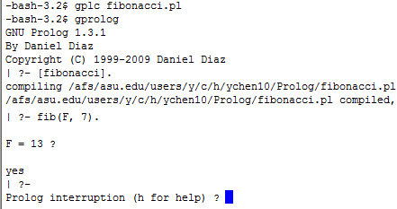
Fibonacci Numbers
0
n
=
0
fib
(
n
)
=
1
n
=
1
fib
(
n
−
1
)
+
fib
(
n
−
2
)
n
≥
2
fib(F, N) :- N =:= 0, F is 0.
fib(F, N) :- N =:= 1, F is 1.
fib(F, N) :- N > 1,
N1 is N-1,
N2 is N-2,
fib(F1, N1),
fib(F2, N2),
F is F1 + F2.
Compiler
Start Prolog
Run fib program
Is this rule a tail-recursive rule?
Compute fib(F, 7)
Result

Slide 16
Recursive Example: Hanoi Towers
The objective of this famous puzzle is
- to move N disks from the left peg to the right peg
- using the center peg as an auxiliary holding peg.
- At no time can a larger disk be placed upon a smaller disk.
- Move one disk at one time.

Slide 17
Example with Four Disks
N disks
Algorithm
N-1 disks
Move N-1 disks
to the center
Move 1 disk
to the right
Move N-1 disks
to the right

Slide 18
Hanoi Towers Program
hanoi(N) :- move(N, source, center, destination).
move(1, S, _, D) :- % stopping condition
write('Move top from '), write(S), write(' to '), write(D),
nl. % nl = newline
move(N, S, C, D) :-
N>1,
M is N-1,
move(M, S, D, C), % move N-1 disks from S to C
move(1, S, _, D), % move remaining 1 from S to D
move(M, C, S, D). % move N-1 disks from C to D
% size-N problem

Slide 19
Hanoi Tower Output
?- hanoi(3).
Move top from source to destination
Move top from source to center
Move top from destination to center
Move top from source to destination
Move top from center to source
Move top from center to destination
Move top from source to destination

Slide 20
Structures of Facts and Rules
Prolog structures represent nested relationships.
Example
course(cse240, tues, thur, 1040, 1130, 140, 230, yinong, chen, coor184, byac150).
This long relationship can be restructured as follows
Structure of an argument: relationship followed by arguments, just like a fact.
course(
cse240,
day(tues, thur),
time(1040, 1130),
instructor(yinong, chen),
coor184
).
course(
cse240,
day(tues, thur),
time(140, 230),
instructor(yinong, chen),
byac150
).

Slide 21
Factbase of Structured Relationship
course( cse210,
day(mon, wed, fri),
time(1340, 1430),
instructor(renee, turban),
ag350
).
course( cse240,
day(tues, thur , _ ),
time(1040, 1130),
instructor(yinong, chen),
coor184
).
course( cse240,
day(tues, thur , _),
time(1340, 1430),
instructor(yinong, chen),
byac150
).
course( cse225,
day(tues, thur , _ ),
time(915, 1030),
instructor(yinong, chen),
scob228
).
course( cse310,
day(mon, wed, fri),
time(940, 1030),
instructor(barb, gannod),
coor184
).
course( cse230,
day(mon, wed, fri),
time(1440, 1530),
instructor(john, doe),
pebe201
).

Slide 22
Rulebase Extended from Factbase
Structured facts easily allow meaningful rules to be added
instructor(Instructor, Class) :-
course( Class,
_, /* Day */
_, /* Time */
Instructor,
_ ). /* Location */
room(Location, Day, Time) :- course( _, Day, Time, _, Location).

Slide 23
Queries to the Rulebase
(1) What instructors teach course cse240 and cse310?
?- instructor(Instructor, cse240).
--> instructor(yinong, chen);
--> instructor(yinong, chen);
--> no
?- instructor(Instructor, cse230).
--> instructor(john, doe);
--> no

Slide 24
Queries to the Rulebase (contd.)
(2) What room is used in what day and time?
?- room(byac150, Day, Time).
--> Day = day(mon, wed , fri);
Time = time(1340, 1430);
--> no
?- room(coor184, Day, Time).
--> Day = day(mon, tue, _)
Time = time(1040, 1130);
--> Day = day(mon, tue, _)
Time = time(1340, 1430);
--> no

Slide 25
Prolog Pair and List Definitions
Using BNF notation, a Prolog pair is defined as
<pair> ::= [<A> | <B>]
where
A is a variable or value;
B is a variable or value.
In the definition, A is "car pair" and B is "cdr pair".
Examples of pairs:
[1 | 2]
[1 | [2 | 3]]
[1 | [2 | [3 | []]]])
What is the output of the rule:
?- member(3, [1 | [2 | 3]]).
?- member(3, [1 | [2 | [3 | []]]]).
?- member([1 | 2], [[1 | 2], 2]).

Slide 26
List Definition
Using BNF notation, a Prolog list can be recursively defined as follows
<list> ::= [] % (empty list)
<list> ::= [<H> | <list>]
where
H is a variable or a value;
If we use [H | T] for a list, H is "car list" and T is "cdr list", and [H | T] is a pair defined in Scheme.
Describe a simplification process to simplify the list
[1 | [2 | [3 | []]]] into [1, 2, 3].

Slide 27
List and List Operations
Similar to Lisp/Scheme, Prolog can be used to process lists.
Factbase:
mother_of(sam, [alice, floyd, conrad]).
?- mother_of(sam, alice). --> no
A list is considered consisting of a head and a tail:
lst = [Head | Tail], where Head: "car lst" and Tail: "cdr lst"
mother_of(sam, [H | T]).
--> H = alice
T = [floyd, conrad]

Slide 28
List and List Operations
mother_of(sam, [alice, floyd, conrad]).
mother_of(jane, [mike, sarah, george]).
mother_of(elaine, [tom, dick]).
?- mother_of(X, [_, _, _]). % who has 3 children
X = sam;
X = jane
?- mother_of(X, [H | [M | george]]).
no
?- mother_of(X, [H | [M | [george]]]).
X = jane H = mike M = sarah

